Slide 1
WHAT GOES INTO A RESUME
Merge
By : Akshay M
Founder and CTO

Slide 2
MergeIntern
Who are we???
We Are An AI Based Platform Designed To Help Students in Getting Tech Internships

Slide 3
Important Points for the today’s Session
Is Resume really Important?
Ingredients to Draft a perfect Resume.
Common confusing Points people usually have in mind.
Q&A

Slide 4
TOPIC
Merge.
Ingredients to Draft a perfect Resume?
Resume defines you
It helps the employer to understand you.
It gives an idea of your creativity and drafting skills.
It provides your contact information for the official correspondence.

Slide 5
TOPIC
Merge.
Pointers in a Resume ?
Find a suitable template (Canva, overleaf.com, MS Word, Google Docs etc.)
Your Basic Info
Career Objective( 3 lines)
Skills
Projects/Portfolio: Links to liknedIn, Github, Website (For tech Students, designers & developers etc.)
Work Experience (Past Internships, Jobs, info about your employer, your tenure & Job Roles)
Certifications
Research papers or Publications, if any
Awards & recognitions

Slide 6
TOPIC
Merge.
Pointers in a Resume ?
Fonts: Times new Roman, Calibri
Font Size: Always send pdf, and make sure your pdf is not locked to be opened with a password, thats a big no
(never send a word file)

Slide 7
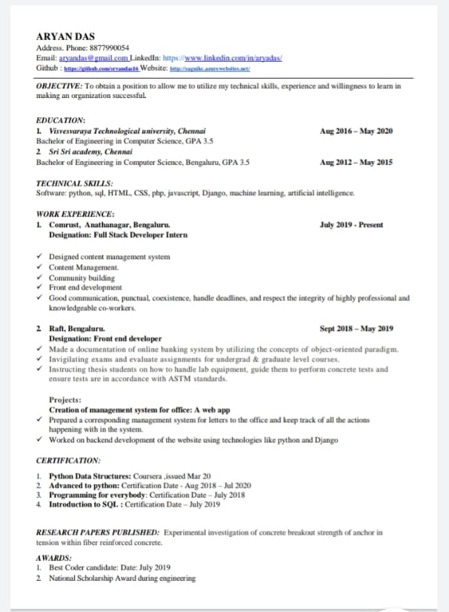
SNEAK PEEK

Slide 8
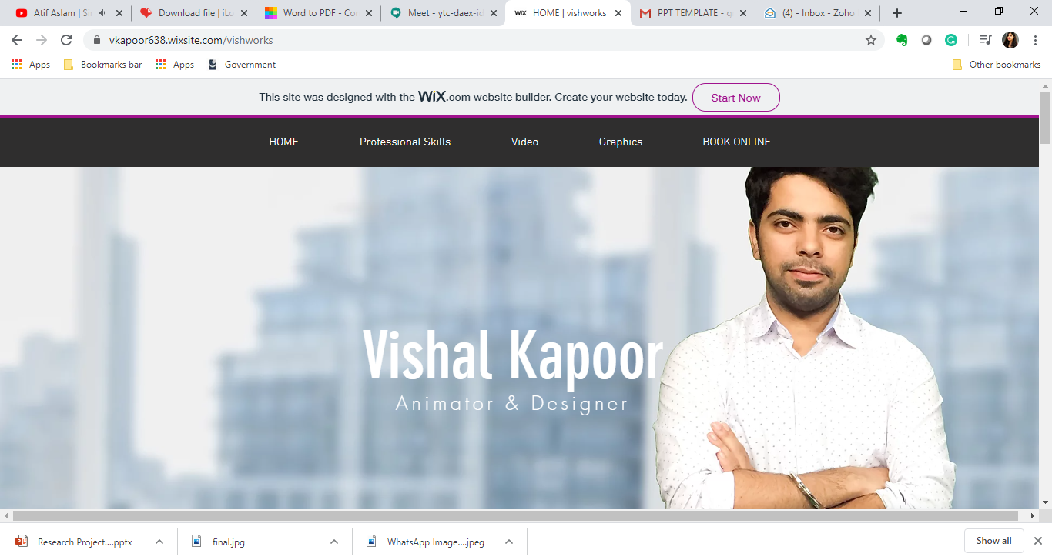
SNEAK PEEK
https://vkapoor638.wixsite.com/vishworks

Slide 9
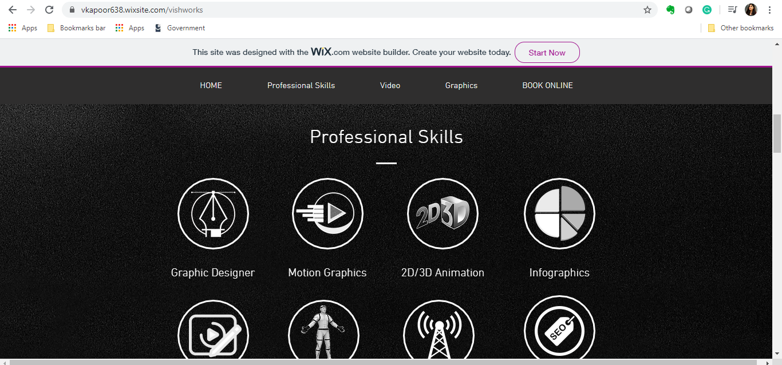
SNEAK PEEK

Slide 10
TOPIC
Merge.
Common confusing Points people usually have in mind.
Number of Pages in a Resume!
Is adding an address important?
Is adding your picture to the resume important?
Is adding a declaration at the end of a resume important?
Is adding languages important?
Use bullet points (Avoid writing stories or paragraphs, keep it short, crispy & interesting)

Slide 11
Any Questions??

Slide 12


THANK YOU
Merge.
akshay@mergeintern.com
Follow Us:

